Slide 1
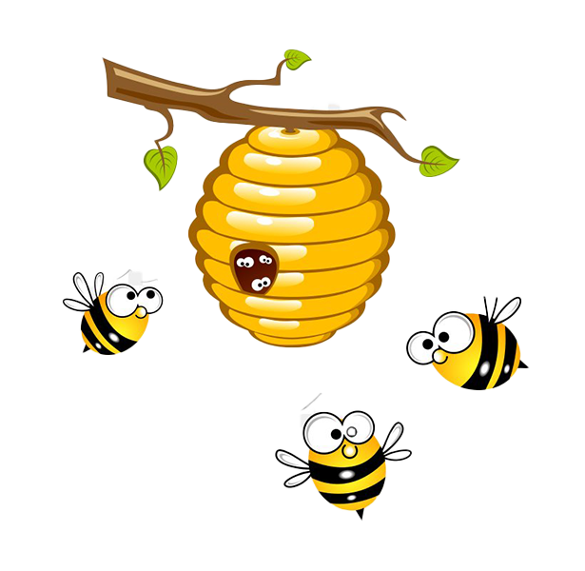


BUZZING BEE GAME USING PYTHON
MS. Rachna (supervisor)
SAPNA SINHA(1/18/FET/BCS/079)
MANSI GARG(1/18/FET/BCS/088)
ANKITA SHARMA(1/18/FET/BCS/091)

Slide 2
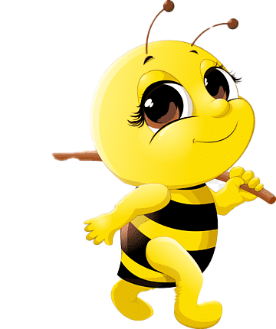
ABSTRACT
Buzzing bee is a mobile game in which a player controls a bee’s flight height to avoid obstacles.
Pressing on the screen for a longer period of time allows the bee to fly higher, while letting go causes the bee to fly lower.
This project will bring the mobile game to life using a video camera to detect a player’s motion, and controls the bee based on the speed at which a player flaps her arms.
The FPS will render an image of the bee flying through an environment, and display the flapping motion of the wings according to the player’s speed.

Slide 3
ABOUT THE GAME
THIS IS A SIMPLE GAME IN WHICH ONE HONEY BEE IS MOVING BETWEEN DIFFERENT OBSTACLES.
IF THE HONEY BEE TOUCHES THEN THE GAME WILL BE END AND THE TOTAL SCORE WILL SHOW ON THE SCREEN.
EVERY TIME THE BEE CROSSES ANY OBSTACLE THE SCORE INCREASES BY 1.

Slide 4
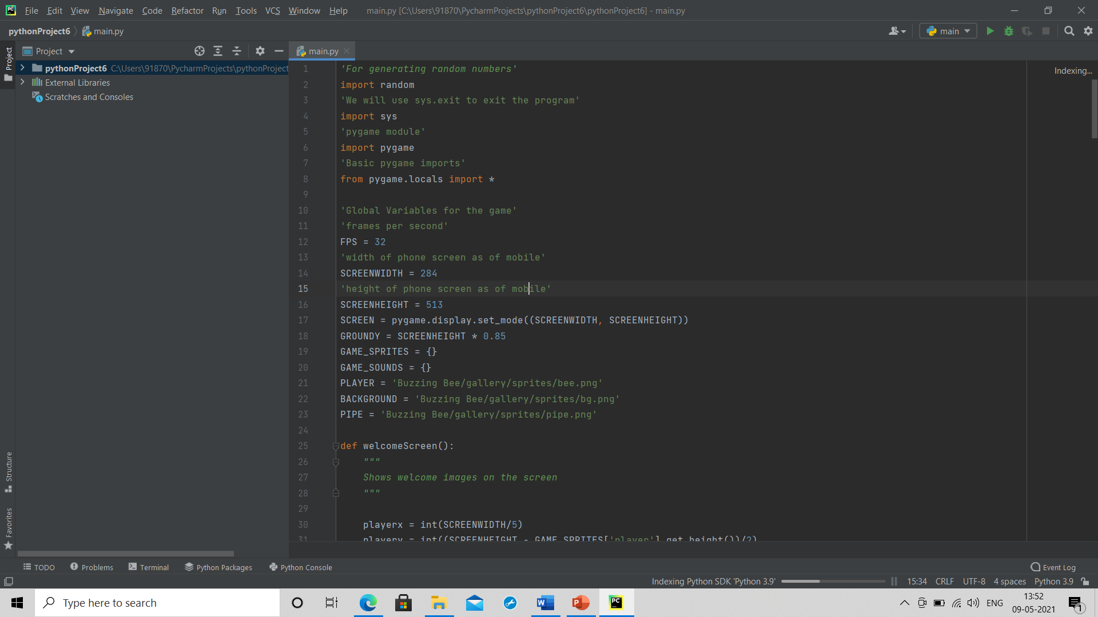
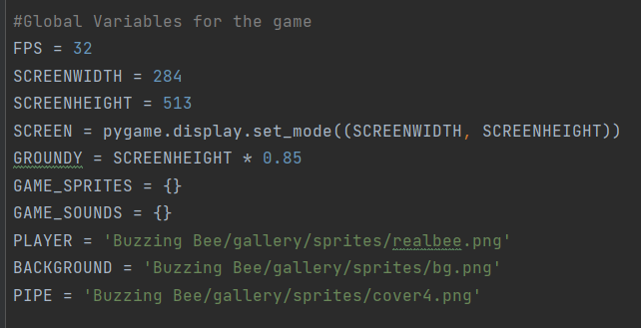
MODULES & GLOBAL VARIBLES
SOME MODULES USED ARE:-
GLOBAL VARIABLES USED ARE :-

Slide 5
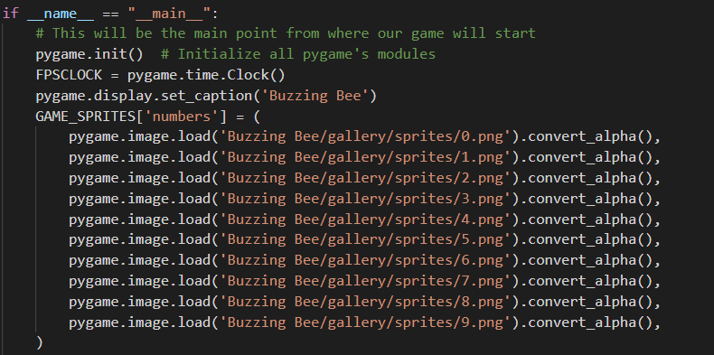
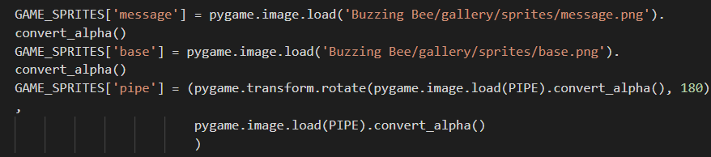
Blitting Images
pygame.init () initialize all Pygame modules.
pygame.time.clock() create an object to track time.
Pygame.image.load() it loads new image from file
Convert.alpha() optimize our game.
pygame.transform.rotate() will rotate our obstacle by 180deg.

Slide 6
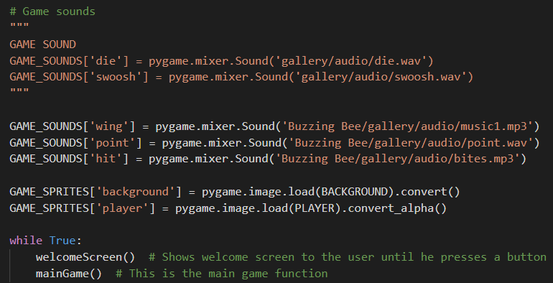
Playing Of Sound
Game_Sounds[wing] = Pygame.mixer.sond(‘path’).
Pygame.mixer.sound() will creates a new sound object from a file

Slide 7
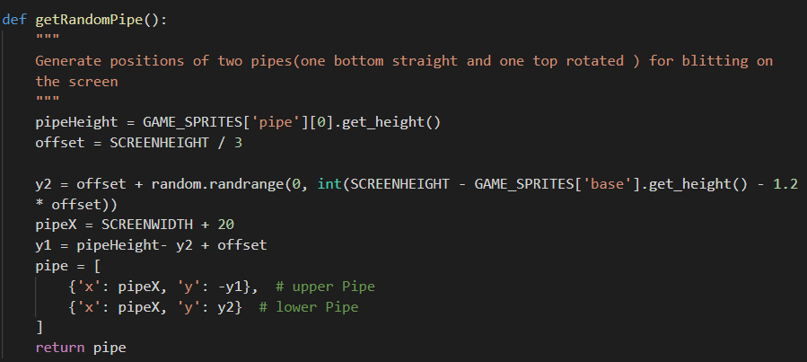
Generation Of Obstacle
Defining a function getRandomPipe() for generation of obstacle randomly.
y2=offset + random.randrange(0, int(SCREENHEIGHT - GAME_SPRITES['base'].get_height() - 1.2 * offset))
y1 = pipeHeight- y2 + offset
pipeX = SCREENWIDTH + 20

Slide 8
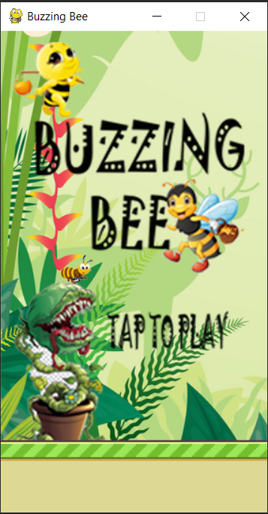
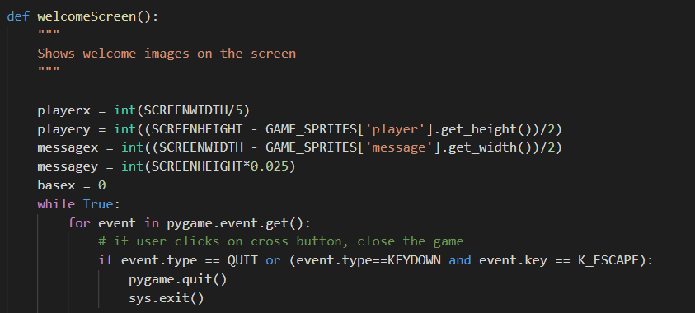
Blitting of Welcome Screen
Declaring a function namely welcomeScreen().
Initialize the co-ordinates of player.
Initialize the co-ordinates of message which will display on our screen before the start of game.
Initialize the base of game.

Slide 9
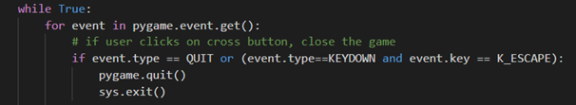
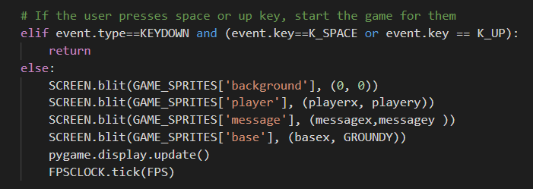
Event when User Press Key
Checking for event by event.get() function.
If event is Cut or Escape quit the game and exit.
If event is spacebar or Up arrow start the game.
Blit image of background,player,message and base.
Pygame.display.update() will update the software display.
FPSCLOCK.tick(FPS) helps us to control the FPS of image.

Slide 10
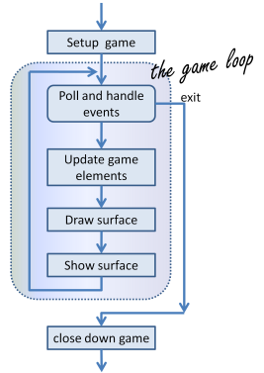
MAIN GAME LOOP
This is the basic work flow of the main loop , and it performs following tasks :-
Captures input event from user
Performs the logic based on the input
Refreshment or Updating of the window
It breaks the loop and exit when an terminate event happens

Slide 11
LOGICS IN MAIN Game LOOP
LOGIC 1 : if type of input event is quitting
LOGIC 2: if type of input event is to start the game
LOGIC 3: if the bee got trapped by plant
LOGIC 4: check and update the score
LOGIC 5: move obstacles(plants) to left
LOGIC 6: if the pipe is out of the screen, remove it
LOGIC 7: Add new obstacle when the first is about to cross the leftmost part of screen
LOGIC 8: Blitting the sprites and numbers as score

Slide 12


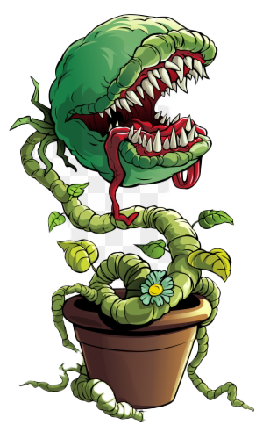
DEMO VIDEO OF BUZZING BEE
Hi! I am Bee, want to reach my home safely. Please help me to reach there without getting trapped in this devil plant.

Slide 13

THANK YOU
FOR
HELPING ME

